Slide 1
Unit II
Virtual Machines and Virtualization of Clusters and Data Centers
Implementation Levels of Virtualization
Virtualization Structures/Tools and Mechanisms
Virtualization of CPU, Memory, and I/O Devices
Virtual Clusters and Resource Management
Virtualization for Data-Center Automation

Slide 2
Implementation Levels of Virtualization
Levels of Virtualization Implementation
VMM Design Requirements and Providers
Virtualization Support at the OS Level
Middleware Support for Virtualization

Slide 3
Levels of Virtualization Implementation
Virtualization:
- a computer architecture technology
- by which multiple virtual machines (VMs) are multiplexed in the same hardware machine.
Purpose of a VM:
- is to enhance resource sharing by many users &
- improve computer performance
(in terms of resource utilization & application flexibility).
Virtualization technology has been revitalized as the demand for distributed & cloud computing increased sharply in recent years.
The idea is to separate the hardware from the software to yield better system efficiency.

Slide 4
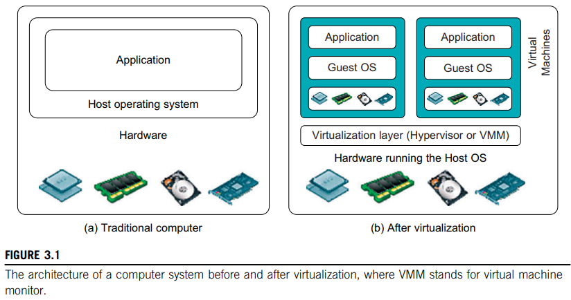
Levels of Virtualization Implementation
A traditional computer - runs with a host operating system specially tailored for its hardware architecture, as shown in Figure 3.1(a).
After virtualization, different user applications managed by their own operating systems (guest OS) can run on the same hardware, independent of the host OS.
This is often done by adding additional software, called a virtualization layer, known as hypervisor or virtual machine monitor (VMM) as shown in Figure 3.1(b).

Slide 5
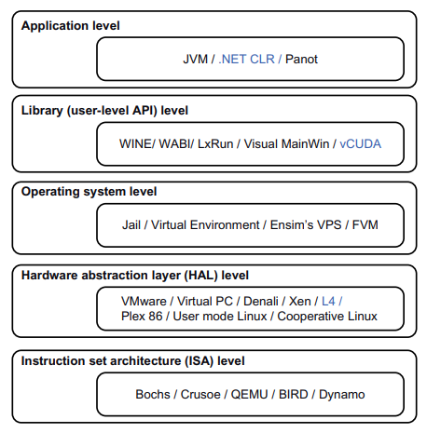

Virtualization software - creates the abstraction of VMs by interposing a virtualization layer at various levels of a computer system.
Common virtualization layers include:
  instruction set architecture (ISA) level,
  hardware level,
  operating system level,
  library support level, and
  application level (see Figure 3.2).

Slide 6
Instruction Set Architecture Level
At the ISA level
- Virtualization is performed by emulating a given ISA.
Instruction set emulation leads to - virtual ISAs created on any hardware machine.
The basic emulation method is through code interpretation.
An interpreter program interprets the source instructions to target instructions one by one.
One source instruction may require tens or hundreds of native target instructions to perform its function.
Obviously, this process is relatively slow.
For better performance, dynamic binary translation is desired.
This approach translates basic blocks of dynamic source instructions to target instructions.

Slide 7
Hardware Abstraction Level
Hardware-level virtualization:
- is performed right on top of the bare hardware.
- generates a virtual hardware environment for a VM &
- process manages underlying hardware through virtualization.
The idea is to virtualize a computer’s resources, such as its processors, memory, and I/O devices.
The intention is to upgrade the hardware utilization rate by multiple users concurrently.

Slide 8
Operating System Level
This refers to an abstraction layer between traditional OS and user applications.
OS-level virtualization:
- creates isolated containers on a single physical server &
- OS instances to utilize the hardware & software in data centers.
The containers behave like real servers.
OS-level virtualization
- commonly used in creating virtual hosting environments
- to allocate hardware resources
- among a large number of mutually distrusting users.

Slide 9
Library Support Level
Most applications use APIs exported by user-level libraries rather than using lengthy system calls by the OS.
Virtualization with library interfaces is possible by controlling the communication link between applications and the rest of a system through API hooks.
Ex: software tool WINE has implemented this approach to support Windows applications on top of UNIX hosts.
Another example is the vCUDA which allows applications executing within VMs to leverage GPU hardware acceleration.

Slide 10
User-Application Level
Virtualization at user application level - virtualizes an application as a VM.
On a traditional OS, an application runs as a process & thus application-level virtualization is also known as process-level virtualization.
Virtualization layer sits as an application program on top of the operating system, and
exports an abstraction of a VM that can run programs written and compiled to a particular abstract machine.
Ex: Microsoft .NET CLR and Java Virtual Machine (JVM) are two good examples of this class of VM.
Application isolation - wrapping the application in a layer that is isolated from the host OS and other applications.
- result is an application that is much easier to distribute & remove from user workstations.

Slide 11
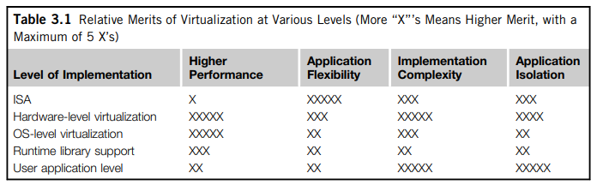
Relative Merits of Different Approaches
Table 3.1 compares relative merits of implementing virtualization at various levels.
Each row corresponds to a particular level of virtualization.
The number of X’s in the table cells reflects the advantage points of each implementation level. (Five X’s – best case & one X - worst case).

Slide 12
VMM Design Requirements and Providers
As discussed, hardware-level virtualization inserts a layer between real hardware and traditional operating systems.
This layer is commonly called the Virtual Machine Monitor (VMM) and it manages the hardware resources of a computing system.
Each time programs access the hardware the VMM captures the process.
- i.e., VMM acts as a traditional OS.
One hardware component - virtualized as several virtual copies.
Therefore, several traditional operating systems (same or different) can sit on the same set of hardware simultaneously.

Slide 13
There are three requirements for a VMM:
1) VMM - provide an environment for programs - identical to the original machine.
2) Programs run in this environment should show only minor decreases in speed (even in worst case).
3) A VMM - complete control of the system resources.
Two possible exceptions are:
- differences caused by the availability of system resources &
- differences caused by timing dependencies.
The former arises - when more than one VM is running on the same machine
The latter qualification is required because of the intervening level of software & effect of any other VMs concurrently existing on same hardware.

Slide 14
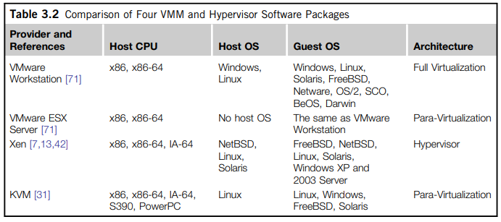
A VMM should demonstrate efficiency in using the VMs. Compared with a physical machine, no one prefers a VMM if its efficiency is too low.
Table 3.2 compares four hypervisors and VMMs that are in use today.

Slide 15
Complete control of these resources by a VMM includes the following aspects:
(1) VMM is responsible for allocating hardware resources for programs;
(2) it is not possible for a program to access any resource not explicitly allocated to it; &
(3) it is possible under certain circumstances for a VMM to regain control of resources already allocated.
Not all processors satisfy these requirements for a VMM.
A VMM is tightly related to the architectures of processors.
Hardware-assisted virtualization – “If a processor is not designed to support virtualization primarily, it is necessary to modify the hardware to satisfy the three requirements for a VMM”.

Slide 16
Virtualization Support at the OS Level
Cloud computing is transforming the computing landscape by shifting the hardware and staffing costs of managing a computational center to third parties.
However, cloud computing has at least two challenges:
1) Ability to use a variable number of physical machines and VM instances depending on the needs of a problem.
Ex: a task may need only a single CPU during some phases of execution but may need hundreds of CPUs at other times.
2) Concerns about the slow operation of instantiating new VMs.
Currently, new VMs originate either as fresh boots or as replicates of a template VM, unaware of the current application state.

Slide 17
Why OS-Level Virtualization
As mentioned, it is slow to initialize a hardware-level VM because each VM creates its own image from scratch.
In a cloud environment, thousands of VMs need to be initialized simultaneously.
Besides slow operation, storing the VM images also becomes an issue.
Moreover, full virtualization at the hardware level also has the disadvantages of slow performance and low density, and the need for para-virtualization to modify the guest OS.
OS-level virtualization provides a feasible solution for these hardware-level virtualization issues.
Operating system virtualization inserts a virtualization layer inside an operating system to partition a machine’s physical resources.
It enables multiple isolated VMs within a single operating system kernel.
This kind of VM is often called a virtual execution environment (VE), Virtual Private System (VPS), or simply container.
From the user’s point of view, VEs look like real servers.
Therefore, OS-level virtualization is also called single-OS image virtualization.
Figure 3.3 illustrates operating system virtualization from the point of view of a machine stack.

Slide 18
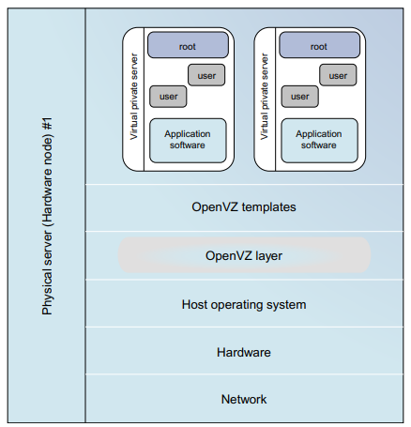


Slide 19
Advantages of OS Extensions
Compared to hardware-level virtualization, benefits of OS extensions are twofold:
(1) VMs at the operating system level have minimal startup/shutdown costs, low resource requirements, and high scalability; &
(2) for an OS-level VM, it is possible for a VM and its host environment to synchronize state changes when necessary.
These benefits can be achieved via two mechanisms of OS-level virtualization:
(1) All OS-level VMs on the same physical machine share a single operating system kernel;
(2) the virtualization layer can be designed in a way that allows processes in VMs to access as many resources of the host machine as possible, but never to modify them.

Slide 20
Disadvantages of OS Extensions
The main disadvantage of OS extensions is that all the VMs at operating system level on a single container must have the same kind of guest operating system.
Ex: Windows distribution such as Windows XP cannot run on a Linux-based container.
However, users of cloud computing have various preferences. Some prefer Windows and others prefer Linux or other operating systems.
Therefore, there is a challenge for OS-level virtualization in such cases.
Figure 3.3 illustrates the concept of OS-level virtualization.
To implement OS-level virtualization, isolated execution environments (VMs) should be created based on a single OS kernel.
Furthermore, the access requests from a VM need to be redirected to the VM’s local resource partition on the physical machine.
Ex: chroot command in a UNIX system can create several virtual root directories within a host OS. These virtual root directories are the root directories of all VMs created.

Slide 21
Virtualization on Linux or Windows Platforms
By far, most reported OS-level virtualization systems are Linux-based.
Virtualization support on the Windows-based platform is still in the research stage.
Linux kernel offers an abstraction layer – to allow software processes to work with and operate on resources without knowing the hardware details.
New hardware may need a new Linux kernel to support.
Therefore, different Linux platforms use patched kernels to provide special support for extended functionality.
Table 3.3 summarizes several examples of OS level virtualization tools that have been developed in recent years.
OS tools (Linux vServer and OpenVZ) - support Linux platforms to run other platform-based applications through virtualization.
FVM - is an attempt specifically developed for virtualization on the Windows NT platform.

Slide 22
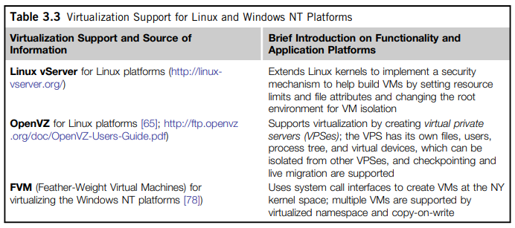

Slide 23
Middleware Support for Virtualization
Library-level virtualization is also known as
user-level Application Binary Interface (ABI) or API emulation.
This type of virtualization can create execution environments for running alien programs on a platform rather than creating a VM to run the entire operating system.
Key functions: API call interception and remapping
Several library-level virtualization systems: namely Windows Application Binary Interface (WABI), lxrun, WINE, Visual MainWin, and vCUDA - summarized in Table 3.4.
WABI - offers middleware to convert Windows system calls to Solaris system calls.
Lxrun - a system call emulator that enables Linux applications written for x86 hosts to run on UNIX systems.
Wine - offers library support for virtualizing x86 processors to run Windows applications on UNIX hosts.
Visual MainWin - offers a compiler support system to develop Windows applications using Visual Studio to run on some UNIX hosts.
The vCUDA – virtualization support for general purpose GPU’s.

Slide 24
